Slide 1
Architecture Design
Customer Segmentation
Revision Number - 1.1
Last Date of Revision - 28/1/2022
AKASH

Slide 2
ARCHITECTURE DESIGN
Document Control
Date | Version | Description | Author
22/1/2022 | 1.0 | Introduction, Architecture, | Akash Shetty
28/1/2022 | 1.1 | Final Revision | Akash Shetty

Slide 3
ARCHITECTURE DESIGN
Contents
Document Version Control…………………………………………………………………………2
1. Introduction……………………………………………………………………………………….4
1.1 What is Architecture Design Document?..............................................................4
1.2 Scope……………………………………………………………………………………4
2. Architecture……….……………………………………………………………………….……...5 2.1 Streamlit Architecture………………………………………………………………….5
3.

Slide 4
ARCHITECTURE DESIGN
1. Introduction
What is Architecture Design Document?
Any software needs the architectural design to represent the design of the software. IEEE defines architectural design as “the process of defining a collection of hardware and software components and their interfaces to establish the framework for the development of a computer system.” The software that is built for computer-based systems can exhibit one of these many architectures.
Each style will describe a system category that consists of:
A set of components (eg: a database, computational modules) that will perform a function required by the system.
The set of connectors will help in coordination, communication, and cooperation between the components.
Conditions that how components can be integrated to form the system.
Semantic models help the designer to understand the overall properties of the system.
1.2 What is Scope?
Architecture Design Document (ADD) is an architectural design process that follows a step-by-step refinement process. The process can be used for designing data structures, required software architecture, source code and ultimately, performance algorithms. Overall, the design principles may be defined during requirement analysis and then refined during architectural design work.

Slide 5
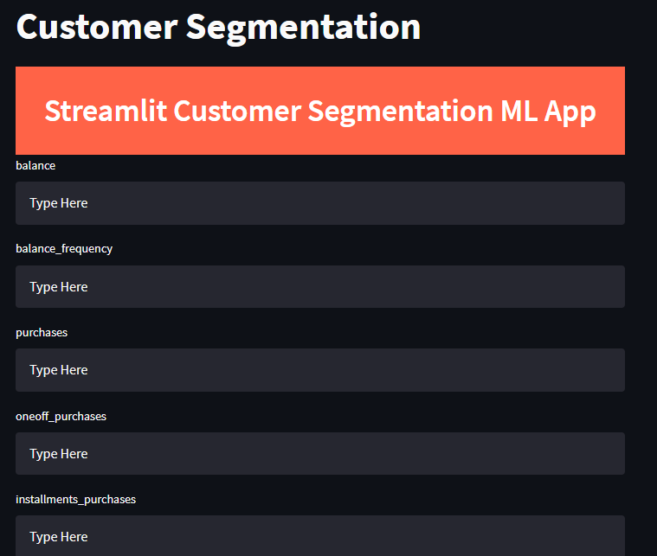
ARCHITECTURE DESIGN
Architecture
Streamlit Architecture
Streamlit apps have a unique data flow: any time something must be updated on the screen, Streamlit reruns your entire Python script from top to bottom. ... Whenever a user interacts with widgets in the app.
In the following model we use streamlit app to collect data (17 different variables ) from each customer and predict which group they belong (group 1,2,3,4) as shown below:

Slide 6
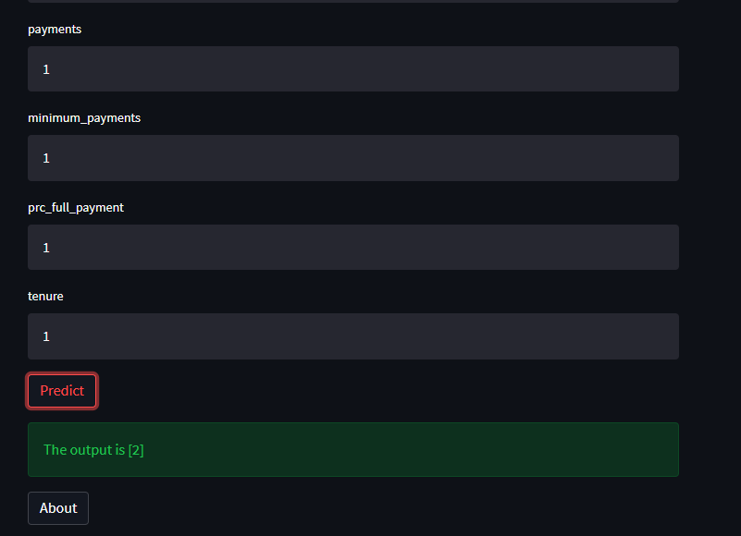
ARCHITECTURE DESIGN
The output is shown as follows :
# The possible outputs are 1,2,3 and 4.

